Slide 1
1.1 - Welcome

Slide 2
Outcomes
After this section you should be able to:
Find the coffee
Name a few of your fellow participants who you didn’t know before
Explain why we’re having this workshop
Explain how you will get back to your hotel

Slide 3
Welcome to Garden City
Garden City, NY (village)
Or East Garden City (hamlet)
Or Hempstead (town)
Nassau County
Which is why NCC doesn’t mean the Bahamas!

Slide 4
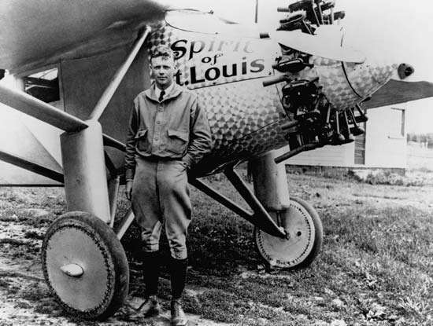
Welcome to Aviation History
Hub of early aviation activity
Site of Charles Lindberg’s departure for Paris
Military base in WWI and WWII
Hazelhurst field
Mitchell field
Roosevelt field

Slide 5
Welcome to Nassau Community College
Largest single campus community college in New York State
22,000 day and evening students
Part of the State University of NY (SUNY)
Computing programs in CS and IT

Slide 6
Welcome to the CCB
Room CCB 251
Here all the time
Amenities

Slide 7
Schedule
http://foss2serve.org/index.php/Pathways_Model_Workshop_2016

Slide 8
Logistics - Food
Thursday
Dinner: here
Friday
Breakfast: at the hotel
Lunch: here
Dinner: Passione Della Cucina
Saturday
Breakfast: at the hotel
Lunch: here or taken with you

Slide 9
Logistics - Food
Drinks and snacks: on demand
Special requests
Vegetarian, gluten, dairy, soy
Anyone not making dinner on Friday?

Slide 10
Logistics - Transportation
Group ride sharing to and from the hotel
Or walking
Group shuttle/taxi to the airport
Information:
https://titanpad.com/PMWG

Slide 11
Purpose of the Workshop
Bring together faculty and HFOSS community representatives
Discuss the shared interest in making people successful contributors to HFOSS projects
Students and others
HFOSS and open source broadly

Slide 12
Purpose of the Workshop
Learn from each other
Explore ways to make contributors more successful
Easier “on-ramps”
Better and more accessible learning materials
Collaborations between universities and HFOSS projects

Slide 13
Tomorrow – Food for Thought
For open source community people
Questions circulated by email
Also available online
For academic people
Questions available online

Slide 14
Acknowledgement and Licensing
Acknowledgement
This material is based on work supported by the National Science Foundation under Grants DUE-1525039, DUE-1524898, and DUE-1524877. Any opinions, findings and conclusions or recommendations expressed in this material are those of the author(s) and do not necessarily reflect the views of the National Science Foundation (NSF)
Copyright and Licensing
This work is copyrighted by the authors
This work is licensed under a Creative Commons Attribution-NonCommercial 3.0 Unported License

