Slide 1





Project Selection for Student Participation in Humanitarian FOSS
Heidi J. C. Ellis - ellis@wne.edu
Gregory W. Hislop – hislop@drexel.edu
Michelle Purcel - mjw23@drexel.edu
Darci Burdge, Lori Postner – NCC
Stoney Jackson – WNE
Sean Goggins – University of Missouri

Slide 2
1. Introductions
Foss2serve.org
TeachingOpenSource.org

Slide 3
2. Set Up
Etherpad: http://openetherpad.org/SIGITEWorkshop

Slide 4
3. What is HFOSS?

Slide 5

Free Software Definition
Free software is a matter of the users' freedom to run, copy, distribute, study, change and improve the software.
Four freedoms
  To run the program, for any purpose
  To study the program works, and change it
  To redistribute copies
  To distribute copies of your modified versions

Slide 6
Legal Mechanisms
How do you implement FOSS within the legal system?
  FOSS is not Public Domain
Copyleft
  Use copyright to control the material
  Share the rights via license
    “making a program (or other work) free, and requiring all modified and extended versions of the program to be free as well.”
Implementation: GNU General Public License
©

Slide 7
FOSS Today
What has resulted from
all this noise about FOSS?

Slide 8






FOSS Today
Notes:
Ask the class if they recognize any of the software mentioned here and whether it is open source.
Point out that sometimes the organizations work separately and are competing, i.e. microsoft office vs. oracle’s open office
Discuss how sometimes open source free projects feed paid products such as Fedora feeds into redhat. Discuss free software foundation vs. open source initiative.
Discuss how Apache web server over 50 percent of the market.
If there’s time mention open source projects produce all types of software, e.g. statistics packages, children’s software.

Slide 9








FOSS Today
Many credible products; some market leaders
Notes:
Ask the class if they recognize any of the software mentioned here and whether it is open source.
Point out that sometimes the organizations work separately and are competing, i.e. microsoft office vs. oracle’s open office
Discuss how sometimes open source free projects feed paid products such as Fedora feeds into redhat. Discuss free software foundation vs. open source initiative.
Discuss how Apache web server over 50 percent of the market.
If there’s time mention open source projects produce all types of software, e.g. statistics packages, children’s software.

Slide 10
Control
Misconception of FOSS as “Free contribution by anyone”
  NOT!
  This would be chaos
Need for control creates a hierarchy
  Version control enables and enforces
  Committers
  Contributors
  Others

Slide 11
Control and Community
“Contributor Mountain”
  Client/customer
    Use in isolation
  Seeker
    Connects to community for answers on using
  Collaborator
    Contributes bug reports, feature requests, …
  Contributor
    Moves project forward
    Relied on by the community

Slide 12
Community
Clients and developers as part of a spectrum
  Not “us” vs. “them”
Assumption that people can move from passive “user” to active participant
  Even without technical skills
See: “Why we won’t call you a ‘user’.”
  http://www.kitware.com/blog/home/post/263

Slide 13
Community
Openness to new participants
  Especially if you approach the project reasonably
Advancement via accomplishment
  Fairly direct meritocracy
Check and balance
  Control of commit authority
    Real point of control for moving the product
  Ability to fork
    Limits autocratic power

Slide 14
Communication
More is generally better
Multiple channels
  Highly distributed participation
    Less elaborate; more immediate
    Rollback mechanisms available (e.g., in a wiki)
  Synchronous and asynchronous
  Low and high bandwidth
Explicit provision for lurkers
  Replaces hallway conversations and discussion in the break room
  Allows for serendipity and learning by osmosis

Slide 15





What is HFOSS
FOSS created to provide social benefit
  Disaster recovery
  Medical records
  Economic development
  Education
  And more!
Extra potential to catch student interest!
  And provide education on professional impact and responsibility

Slide 16
4. Student Participation

Slide 17
Challenges
FOSS project complexity
  Code and technology base
  Tools used
FOSS culture and process
  Dynamics of interaction with FOSS communities
  Release schedules and process
Meaningful involvement for students
  FOSS project cooperation
  Maintaining local knowledge of project over time

Slide 18



Learning Opportunities - Technical
Coding, testing and debugging
Code reading and
understanding
Specification and design
Development platforms
  E.g, mobile
Tools
http://www.xcitegroup.org/softhum/doku.php?id=f:50ways
Notes:
Give examples of

Slide 19
Learning Opportunities – Soft Skills
Teamwork
Communication
Cultural exposure
Understanding of humanitarian issues
Intellectual property
Notes:
Give examples of

Slide 20
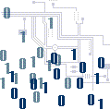
Learning Opportunities –
Domain Knowledge
Health systems
Financial systems
Cryptography
Bioinformatics
Social issues
Notes:
Give examples of

Slide 21
Students Have…
Created install instructions for the dev environment for OpenMRS
Added a keyboard to the Caribou onscreen keyboard
Written guidelines for downloading and installing products
Added color filters to vision software
Created a volunteer management module for disaster management software

Slide 22
Stories…
Volunteer registration at Strong Angel III
Invitation to conference in So. Africa
GNOME Summit

Slide 23
5. Locating Projects

Slide 24
Project Location
Peruse sites for potential projects
  Sourceforge – sourceforge.net
  GitHub - github.com
  Launchpad - launchpad.net
  Ohloh - ohloh.net
  Gitorious - gitorious.org
  List of HFOSS projects:
  http://www.xcitegroup.org/softhum/doku.php?id=g:hfoss_and_oss_projects
Identify 5-6 potential projects
Narrow down to three most interesting
Other resources: TeachingOpenSource.org and foss2serve.org
Notes:
Questions that could guide their initial search? Domain/student interest/platform (e.g, mobile)
Mention that not all data are available at each site so is beneficial to use more than one. Give example.
Go out to SourceForge, show searching the forge.
Go out to Ohloh, show statistics.
Mention that not you can return to the larger set if one does not work out in your eval.

Slide 25
You Try It!
Start at ohloh.net
  How much you can learn about Mifos in 10 minutes?
  How many developers? Commit pattern? Activity? Who are the managers?
  Language(s)? Size of code base? Technical docs?
Full activity:
  http://www.foss2serve.org/index.php/Intro_Project_Identification_Activity

Slide 26
6. Evaluation Model
Follow on using Mifos

Slide 27
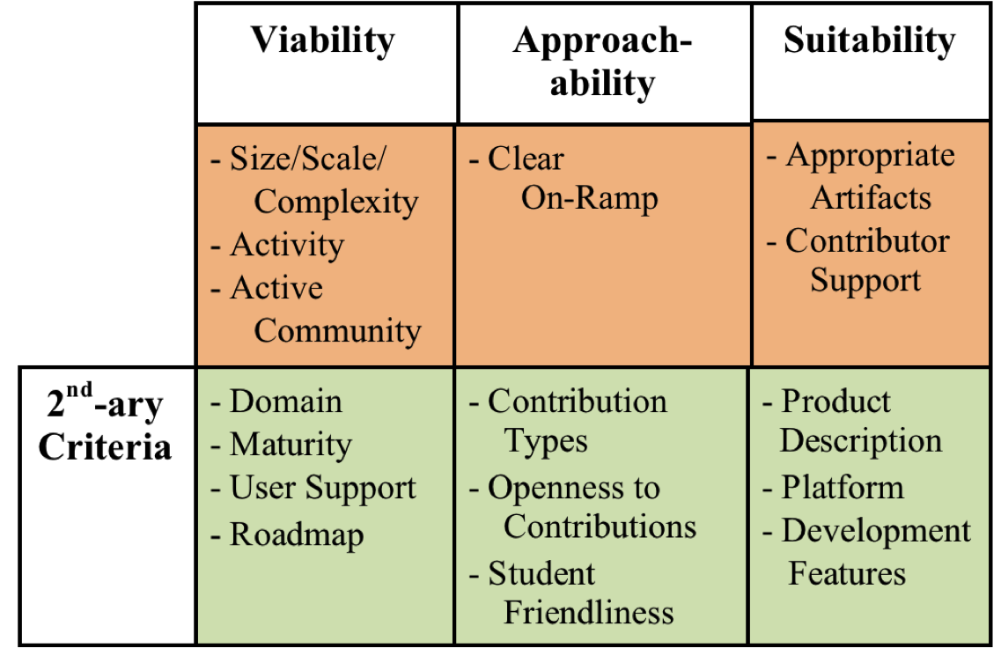
The Model - 1
Notes:
Need a better graphic
Here discuss the model from high level
Dimensions
Viability-is it a community that is likely to continue? Is the project too complex?
Approachability – does it appear that it is a project that students can contribute to without having to spend an inordinate amount of time identifying how to do so?
Suitability – does it support the learning objectives?
Mission critical – evaluated first, pass or fail (do have to satisfy all criteria)
Secondary criteria – scored-approach (don’t have to satisfy all criteria)

Slide 28
The Model - 2
Rate criteria on scale of one to three
  Three is “best”
Mission Critical Criteria: Must be present to support student success
  No rating of less than two is acceptable
Secondary Criteria: Contribute to the success but lack does not lead to failure
  Total score above 20 indicates a viable project

Slide 29
Mission Critical
Viability – Size, Scale Complexity
Remember that students do not need to understand entire project
LOC: 96 KLOC – 5 MLOC
  Very dependent on architecture
Architecture: Modular architectures best
  E.g., plug-in architecture
Number of committers: ~6 within the last 12 months

Slide 30
Mission Critical
Viability – Activity
Commits per month: 10-30 is reasonable
  Look back a year or so for commit pattern
  Projects may have cyclic commit pattern

Slide 31
Mission Critical
Viability – Community
Active user and developer communities
Regular history of project downloads
Regular documentation updates
Current activity on user mailing lists
Be careful of:
  Long lags between updates
  Current questions unanswered on forums
  No recent history of downloads

Slide 32
Mission Critical
Approachability – On-ramp
Must have identifiable way for new people to contribute
Rubric:
  Insufficient: few or no pointers on how to get involved
  Sufficient: Suggestions about how to get involved other than contributing money
  Ideal: Obvious link to getting started including list of tasks needed to be completed and detailed instructions

Slide 33
Mission Critical
Suitability – Appropriate Artifacts
Must have artifacts/tasks that support learning for your class
  Documentation, testing, design, coding, etc.
  Multiple opportunities for a variety of different kinds of contributions is best

Slide 34
Mission Critical
Suitability – Contributor Support
Ideal: Community provides lots of guidance
Project should contain information on how project is administered and managed
Communication tools clearly documented
Developers have a web presence
Processes for getting change committed, feature selection etc. well documented.
Responses to questions on IRC/list should be supportive and timely

Slide 35
Secondary
Suitability – Domain and Maturity
Domain: Understandability can impact learning
  E.g., Software for Nuclear Magnetic Resonance vs. gaming software
Maturity: Should have at least one stable release
  Otherwise project may not have sufficient organization to support student learning

Slide 36
Secondary
Suitability – User Support & Roadmap
User Support: Clear instructions for downloading, installing and using product
  FAQs, forums, and lists
  Quality of end-user documentation
Does project have clear roadmap for future?
  Provides students with understanding of forward direction

Slide 37
Secondary
Approachability – Contribution Types and Openness
Support for multiple contribution types?
  More is better
Openness to contributions
  Does project accept external patches
  Description of how to get changes committed
  Identification of committers
  Be wary of projects that do not accept changes not from core members

Slide 38
Secondary
Approachability – Student Friendliness
Ideal project welcomes and values student contributions
  Check tone of discussion on IRC and forums
  Is “flaming” is tolerated?
Evidence of previous student participation is helpful
  E.g., Google Summer of Code

Slide 39
Secondary
Suitability
Product: Students must be able to understand what product does
Platform: Do you have support for platform project runs on?
Development features:
  Programming language
  Development environment
  Supporting technologies: database packages, libraries, etc.

Slide 40
Other Factors
Sizzle! Is project attractive to students?
Long-term prospects: Is this a project that could be used for more than one term?
Ownership: Does project hold possibility for students to have a sense of “ownership”?
  Will students want to follow the project during future development?

Slide 41
Project Evaluation Activity
http://foss2serve.org/index.php/Project_Evaluation_Activity

Slide 42
7. Getting Started

Slide 43
Getting Started
Step 1: Getting Organized - 1
Project evaluation activities should help you identify possible HFOSS projects.
Cursory examination for:
Project Wiki/Page | Committers
Mailing list(s) | Bug Tracking
Roadmap | Source Code Control
Documentation | Releases
IRC

Slide 44
Getting Started
Step 1: Getting Organized - 2
Think about kinds of deliverables for students.
Find Roadmap/bug tracker and identify possible contributions.
  See if you can trace the process of one or more bug fixes or enhancements

Slide 45
Getting Started
Step 2: Lurking
Join mailing list(s) and observe for several weeks.
  Read logs for several months or year back
  Who are the major community members and what are their roles?
Join IRC and lurk.
Identify meeting times and lurk in meetings.
  What are the areas of interest to the community?

Slide 46
Getting Started
Step 3: Introducing Yourself - 1
Introduce yourself and your motivation for joining the group.
Identify what you (and students) can contribute to the project.
  Not details, but generalities (e.g., work on documentation)
Describe the student body that
you’ll be introducing to the
community.

Slide 47
Getting Started
Step 3: Introducing Yourself - 2
Identify what you are looking for from the community.
  Project ideas?
  Contact for particular aspect (e.g., documentation)
Remember, goal is to facilitate student entrance into the community, not “find a project”.

Slide 48
Getting Started
Step 4: Finding Things To Do – 1
Identify a small task that you can accomplish.
  Identify the committer and commit process for the task
Let the community know what you’re working on.
Accomplish the task and get it committed!

Slide 49
8. Wrap Up
Want to join us??
POSSE

Slide 50

Questions?
Links:
  Foss2serve – http://foss2serve.org
  Teaching Open Source – http://teachingopensource.org
  http://HFOSS.org
  Producing Open Source Software - http://producingoss.com/
  The Cathedral and The Bazaar http://catb.org/~esr/writings/homesteading/
  http://OpenSouce.com
  http://openhatch.org

Slide 51
Licensed Under Creative Commons
Attribution-ShareAlike 3.0 Unported (CC BY-SA 3.0)
Users of this material are able remix, tweak, and build upon this work even for commercial purposes, as long as they credit the contributors and license their new creations under the identical terms. All new works based on this material will carry the same license, so any derivatives will also allow commercial use.
http://creativecommons.org/licenses/by-sa/3.0/

