Slide 1





Getting Started in Open Source -
A Tour of a Real Project

Slide 2
Acknowledgement and Licensing
Acknowledgement
  This material is based on work supported by the National Science Foundation under Grants DUE- 1225738, 1225688, and 1225708. Any opinions, findings and conclusions or recommendations expressed in this material are those of the author(s) and do not necessarily reflect the views of the National Science Foundation (NSF)
  The original development of POSSE was accomplished with support by Red Hat, Inc.
Copyright and Licensing
  This work is copyrighted by the authors
  This work is licensed under a Creative Commons Attribution-NonCommercial 3.0 Unported License

Slide 3
Set-Up - Pads
Live, shared, web-based text editor
Open source: http://etherpad.org/
Free services
  http://titanpad.com/
  http://openetherpad.org/
Go to: http://titanpad.com/CCSCNE2014
Add your name and organization

Slide 4
SetUp - IRC
Common form of communication
Download and install IRC client:
  Firefox Chatzilla: https://addons.mozilla.org/en-US/firefox/addon/chatzilla/
  Chrome CIRC https://chrome.google.com/webstore/category/apps
  Mac Colloquy: http://colloquy.info/
/attach freenode.net
/join #foss2serve

Slide 5

Lay of the Land

Slide 6

Free Software Definition
Free software is a matter of the users' freedom to run, copy, distribute, study, change and improve the software.
Four freedoms
  To run the program, for any purpose
  To study the program works, and change it
  To redistribute copies
  To distribute copies of your modified versions

Slide 7
Legal Mechanisms
How do you implement FOSS within the legal system?
  FOSS is not Public Domain
Copyleft
  Use copyright to control the material
  Share the rights via license
    “making a program (or other work) free, and requiring all modified and extended versions of the program to be free as well.”
Implementation: GNU General Public License
©

Slide 8
FOSS Today
What has resulted from
all this noise about FOSS?

Slide 9






FOSS Today
Notes:
Ask the class if they recognize any of the software mentioned here and whether it is open source.
Point out that sometimes the organizations work separately and are competing, i.e. microsoft office vs. oracle’s open office
Discuss how sometimes open source free projects feed paid products such as Fedora feeds into redhat. Discuss free software foundation vs. open source initiative.
Discuss how Apache web server over 50 percent of the market.
If there’s time mention open source projects produce all types of software, e.g. statistics packages, children’s software.

Slide 10








FOSS Today
Many credible products; some market leaders
Notes:
Ask the class if they recognize any of the software mentioned here and whether it is open source.
Point out that sometimes the organizations work separately and are competing, i.e. microsoft office vs. oracle’s open office
Discuss how sometimes open source free projects feed paid products such as Fedora feeds into redhat. Discuss free software foundation vs. open source initiative.
Discuss how Apache web server over 50 percent of the market.
If there’s time mention open source projects produce all types of software, e.g. statistics packages, children’s software.

Slide 11
Control
Misconception of FOSS as “Free contribution by anyone”
  NOT!
  This would be chaos
Need for control creates a hierarchy
  Version control enables and enforces
  Committers
  Contributors
  Others

Slide 12
Control and Community
“Contributor Mountain”
  Client/customer
    Use in isolation
  Seeker
    Connects to community for answers on using
  Collaborator
    Contributes bug reports, feature requests, …
  Contributor
    Moves project forward
    Relied on by the community

Slide 13
Community
Clients and developers as part of a spectrum
  Not “us” vs. “them”
Assumption that people can move from passive “user” to active participant
  Even without technical skills
See: “Why we won’t call you a ‘user’.”
  http://www.kitware.com/blog/home/post/263

Slide 14
Community
Openness to new participants
  Especially if you approach the project reasonably
Advancement via accomplishment
  Fairly direct meritocracy
Check and balance
  Control of commit authority
    Real point of control for moving the product
  Ability to fork
    Limits autocratic power

Slide 15
Communication
More is generally better
Multiple channels
  Highly distributed participation
    Less elaborate; more immediate
    Rollback mechanisms available (e.g., in a wiki)
  Synchronous and asynchronous
  Low and high bandwidth
Explicit provision for lurkers
  Replaces hallway conversations and discussion in the break room
  Allows for serendipity and learning by osmosis

Slide 16





What is HFOSS?
FOSS created to provide social benefit
  Disaster recovery
  Medical records
  Economic development
  Education
  And more!
Extra potential to catch student interest!
  And provide education on professional impact and responsibility

Slide 17

Finding a Community

Slide 18
It’s All About Community
Mindset: Joining a HFOSS community.
  Not working on a project
Community drives the project, not vice versa.
Need to work within the community not as individual outside of community.

Slide 19
Get to Know Your Community - 1
Each Community has its’ own culture
Channels of communication
Processes for code review/submission
  E.g., File a bug and attach a patch, send to mailing list
(Un)written rules
  Whom must you “convince”?
  Style conventions

Slide 20
Get to Know Your Community - 2
Big communities are made of sub-communities
  Based on modules – or subsets of code
  Based on task area
Sub-communities are made up of individuals
  Located all over the world
  With quirks and pet peeves

Slide 21
Get to Know Your Community - 3
Getting lost in the forest
  IN THEORY, all projects have up-to-date roadmaps, etc.
  Everyone in FOSS was once a newbie
    But have forgotten what it is like
Get connected; stay connected!!!!!
  Figuring out all of this takes time
  Best to figure it out all once
  The community will look out for you

Slide 22

Project Tour - MouseTrap

Slide 23
All Projects Need:
Form of communication
  Wiki, IRC, pads, code repository
Identified leadership
Place to store code
  “repo” - git, github, sourceforge
  Version control
Plan for development
  Bug/issue tracker
  Roadmap

Slide 24
FOSS Communication Needs
FOSS project communities are distributed
  Globally distributed development teams
  Global user base
Many FOSS participants are part time
  Communication must span time zones and irregular schedules
FOSS project teams must accommodate turn-over
  Need to support lurkers
  Historical trail is helpful

Slide 25
FOSS Communication Tools
IRC and Meetbots
  Technology is interesting but not really leading edge
    Mostly looks like clunky chat or IM
    Meetbot adds some interest
Wiki’s, forums, listservs
Blogs and Planets

Slide 26
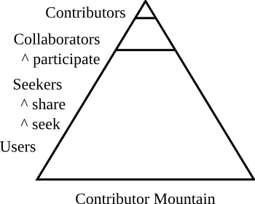
FOSS Leadership
Misconception of FOSS as “Free contribution by anyone”
  NOT! This would be chaos
Need for control creates a hierarchy
  Version control enables and
  enforces
  Committers
  Contributors
  Others
Look for leaders in commit status for code repository, patches in issue tracker, IRC/list logs

Slide 27
Code Repository
“Repo”
Publicly accessible
Frequently also serves as a communication mechanism

Slide 28
Issue Tracker
“Bug tracker”
  Bugzilla, Trac, etc.
Bugs described and listed including severity
Comments can be added as well as patches submitted
Also serves as a major form of communication in some projects

Slide 29
MouseTrap - 1
Communication:
  Wiki: https://wiki.gnome.org/Projects/MouseTrap
  IRC:
    Server: irc.gnome.org
    Channel: #mousetrap
Leadership:
  Heidi Ellis, Stoney Jackson, Joanie Diggs, Alejandro Pinero
Code storage (git repo): https://git.gnome.org/browse/mousetrap/

Slide 30
MouseTrap - 2
Bugzilla: https://bugzilla.gnome.org/
  Search for MouseTrap

Slide 31
Project Evaluation

Slide 32
Good Project vs. Bad Projects
Some projects lend themselves to student interaction more than others.
Ellis, H.J.C., Purcell, M., and Hislop, G., “An Approach for Evaluating FOSS Projects for Student Participation,” SIGCSE 2012, Technical Symposium on Computer Science Education, Raleigh, NC, Mar. 2012.

Slide 33
Step 1: Choose an Evaluation Set
Peruse sites for potential projects
  GitHub
  Sourceforge
  Ohloh
  OpenHatch
Identify 5-6 potential projects
Narrow down to three most interesting
Notes:
Questions that could guide their initial search? Domain/student interest/platform (e.g, mobile)
Mention that not all data are available at each site so is beneficial to use more than one. Give example.
Go out to SourceForge, show searching the forge.
Go out to Ohloh, show statistics.
Mention that not you can return to the larger set if one does not work out in your eval.

Slide 34
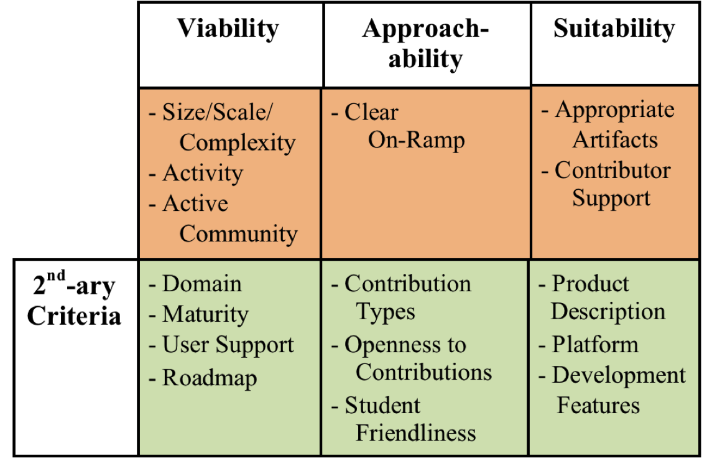
Step 2: Evaluation
Notes:
Need a better graphic
Here discuss the model from high level
Dimensions
Viability-is it a community that is likely to continue? Is the project too complex?
Approachability – does it appear that it is a project that students can contribute to without having to spend an inordinate amount of time identifying how to do so?
Suitability – does it support the learning objectives?
Mission critical – evaluated first, pass or fail (do have to satisfy all criteria)
Secondary criteria – scored-approach (don’t have to satisfy all criteria)

Slide 35

Mission Critical Criteria
Viability
Size/Scale/Complexity
Activity
Community
Evaluate on a 3-point scale. Less than two points on any criterion exclude project from consideration.
Notes:
Size/Scale/Complexity-Will the student be able to comprehend the structure of the project and how to contribute?
Can look at LOC and modularity in tandem. Also, number of contributors. Reasonable number, at least 6 in last month. Smaller than this, may not support student learning. However, too much (?what’s too much) may be too complex.
*Where do I find this?
Activity-Is this project ongoing and likely to continue?
10 commits/month minimum, 30 commits/month over the last year is favorable. Can examine in Ohloh.
Community-Are there users? Can this project help support the learning process
Regular history of downloads, testimonials, user mailing list activity, IRC chat, user forum questions answered, documentation updates

Slide 36
Mission Critical Criteria
Approachability
On-ramp/guidelines
  How to become involved
  How to learn
  How to contribute
Notes:
To successfully support student participation it must be accessible by students.
3-point scale-Insufficient, sufficient, ideal
I should go out to a site and give examples

Slide 37

Mission Critical Criteria
Suitability
Appropriate artifacts
Contributor support
  Developer presence
  Supportive atmosphere
  Operating processes documented
Notes:
Does the project have activities students can participate in that support the learning objectives of the course?
Appropriate artifacts – Example, a course attempting to teach technical writing should make certain the choice of FOSS project provides opportunity to contribute to documentation.
Contributor support – High volume of support and material to support learning and contribution.

Slide 38
Secondary Criteria
Viability | Approachability | Suitability
-Domain -Maturity -User Support -Roadmap | -Contribution Types -Openness to Contributions -Student Friendliness | Product Description Platform Development Features
Evaluate on a 3-point scale. Score greater than 20 is a viable project.
Notes:
Explain these quickly.
Mention that < 20 may require reexamination of low scoring items to see if those would negatively impact student involvement if you still wished to try and pursue using the project.
Evaluate on a 3-point scale. Score greater than 20 is a viable project.

Slide 39
Other Considerations
Sizzle-factor
  Humanitarian
  Gaming
  Mobile
Sense of “ownership”
Long-term prospects
Notes:
Sizzle-factor- How attractive is the project to students, e.g, appeal (gaming) and humanitarian focus.
Long-term prospects – ability to support student participation in future terms enables reuse and may reduce instructor prep time and effort.
Ownership – What’s the potential for students to participate in the project after the class is over? Community involvement aids in creating a sense of “ownership” and may increase motivation and learning.

Slide 40
Hands On – 15 minutes
Compare Two Projects
MouseTrap:
  https://wiki.gnome.org/MouseTrap
Helios:
  http://www.helios-foundation.org/
Evaluation template:
  www.foss2serve.org/images/foss2serve/0/0c/Blank_Evaluation_Template.xlsx

Slide 41

Getting Started

Slide 42
Getting Started
Step 1: Getting Organized - 1
Project evaluation activities should help you identify possible HFOSS projects.
Cursory examination for:
Project Wiki/Page | Committers
Mailing list(s) | Bug Tracking
Roadmap | Source Code Control
Documentation | Releases
IRC

Slide 43
Getting Started
Step 1: Getting Organized - 2
Think about kinds of deliverables for students.
Find Roadmap/bug tracker and identify possible contributions.
  See if you can trace the process of one or more bug fixes or enhancements

Slide 44
Getting Started
Step 2: Lurking
Join mailing list(s) and observe for several weeks.
  Read logs for several months or year back
  Who are the major community members and what are their roles?
Join IRC and lurk.
Identify meeting times and lurk in meetings.
  What are the areas of interest to the community?

Slide 45
Getting Started
Step 3: Introducing Yourself - 1
Introduce yourself and your motivation for joining the group.
Identify what you (and students) can contribute to the project.
  Not details, but generalities (e.g., work on documentation)
Describe the student body that
you’ll be introducing to the
community.

Slide 46
Getting Started
Step 3: Introducing Yourself - 2
Identify what you are looking for from the community.
  Project ideas?
  Contact for particular aspect (e.g., documentation)
Remember, goal is to facilitate student entrance into the community, not “find a project”.

Slide 47
Getting Started
Step 4: Finding Things To Do – 1
Identify a small task that you can accomplish.
  Identify the committer and commit process for the task
Let the community know what you’re working on.
Accomplish the task and get it committed!

Slide 48
Download and Install MouseTrap
http://foss2serve.org/index.php/
MouseTrap_Dev_Help#Complete_Git_and_Mousetrap_Install

Slide 49

BREAK!

Slide 50

Finding Things for Students

Slide 51
Scope of Learning
Student learning can span:
  HFOSS as an item to be studied
  Draw artifacts from HFOSS
  Contribute back to HFOSS
  Individual assignments or sequences of assignments

Slide 52
Activity Structure
Students could work as:
  Individuals, pairs, teams, interacting teams
Deliverables could be:
  Development artifacts, assignments, blog posts, podcasts, vlogs, wiki pages, articles for magazines, newspapers, web sites, etc.
Results could be
  Submitted to instructor for evaluation, submitted to the HFOSS community for comment, posted or shared for peer review , presented in class, discussed in class or online, etc.

Slide 53
Myriad Activities
Most HFOSS projects desire contributions beyond code.
Most HFOSS projects provide opportunities for a variety of learning activities

Slide 54
50 Ways to be a FOSSer
http://xcitegroup.org/softhum/doku.php?id=f:50ways
Use & Evaluate
FOSS Participants
HFOSS Project Overview
Communication
Tools
Business Model
Philosophy and Politics
Privacy and Security
Documentation
Visual Design
Quality and Testing
Usability
Design
Style
Coding

Slide 55
Example - FOSS Participants
Interview a FOSS user and find out why they use FOSS, benefits/drawbacks, etc.
Interview a FOSS contributor to find out how they got involved, their role(s), their background, etc.
Shadow a FOSS contributor over time to see what they do, and summarize.

Slide 56
Example - HFOSS Project Overview
Research history of HFOSS project and summarize.
  When did it start? How many releases? How many users?
Review archived discussion of a chat, thread, or forum and summarize, categorize or reflect on the content.
Study completed defect or feature proposal, and create a concise summary.
  Include details, people involved and roles, steps taken, etc.
  Verify the bug if possible

Slide 57
Example - Communication
Choose an RSS client, subscribe to RSS feeds for HFOSS, read, and summarize.
Subscribe to an IRC channel, listen to a meeting, write summary.
Work remotely with another student to develop profiles for each other
Study the social norms of communication within a FOSS community. (i.e. how to ask questions, respond, etc.)

Slide 58
Example - Usability
Evaluate usability of a specified feature or screen and summarize results.
  Using formal guidelines or rubric
  Using heuristic evaluation
Evaluate accessibility of feature/screen.
Brainstorm list of possible enhancements for project, choose a few to document.

Slide 59

The Course: Software Engineering
Senior-level software engineering course
Two 75 minute meetings per week
Goals:
  Expose students to major development steps
    Requirements, design, code, test, maintenance
  Provide experience with complex, on-going project
  Involve students in professional community

Slide 60

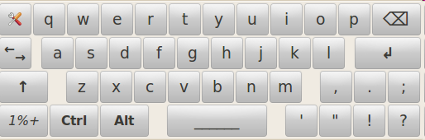
The Project: Caribou
On-screen keyboard
Part of GNOME desktop environment
Use by mouse or switch device
Customizable
  Keyboard layout, font, color, etc.

Slide 61

Caribou Development Environment
1500 lines of Python code
  Download from git repository
  8 files
  15 classes
Keyboards stored as XML or JSON format
Code organization relatively complex
  Creation involves multiple install.sh and make files
  Four levels of directories and make files
We wrote requirements, design, test spec, and made code contributions

Slide 62
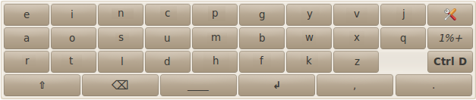
Student Enhancements:
English Lexical Keyboard
Also added:
  Shift Key
  Esc Key
  Delete Key (vs backspace)
  Page Up, Page Down

Slide 63
Contributing Back and Winding Down

Slide 64
Giving Back
FOSS survives on contributions from users and developers.
Pay back in:
  Documentation, reviews, testing, answering questions, etc.
You don’t have to be an expert.
Small contributions can be very valuable.
  Most people start with small contributions.

Slide 65
Winding Down
It's better to communicate undone work than to do uncommunicated work.
When courses end students need to gracefully hand off/close their work.
  Document remaining work
  Try to find someone to take it on
  Or at least to leave it in findable place with a clear indication that a maintainer is now needed.
Contribution isn’t “complete” until hand off is complete.

Slide 66

7. Conclusion
Other projects that might fit:
  Ushahidi
  OpenMRS
  Sahana

Slide 67
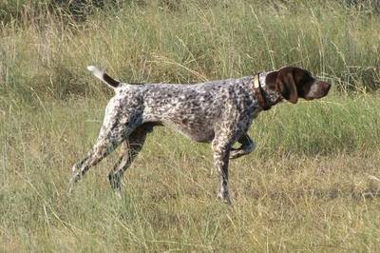
Pointers – General
“Producing Open Source Software.”
  Karl Fogel and O’Reilly Media
  http://producingoss.com/
“Open Advice”
  http://open-advice.org/
“The Open Source Way”
  Karsten Wade, Red Hat
  http://theopensourceway.org

Slide 68
Pointers - General
“OpenSource.com”
  Red Hat
  http://opensource.com/
“The Cathedral and the Bazaar”
  Eric Raymond
  http://www.catb.org/esr/writings/homesteading/
Pop culture to explain FOSS
  http://www.youtube.com/watch?v=m1rDkolRvwo

Slide 69
Pointers - Humanitarian
NSF project series
  HFOSS
    http://hfoss.org/
  SoftHum
    http://xcitegroup.org/softhum
  HumIT
    http://xcitegroup.org/humIT
  Foss2serve
    http://foss2serve.org
    Will incorporate SoftHum and HumIT

