Slide 1




Project Selection for Student Participation in Humanitarian FOSS
Heidi J. C. Ellis - ellis@wne.edu
Lori Postner – lori.postner@ncc.edu
Gregory W. Hislop – hislop@drexel.edu
Stoney Jackson – hjackson@wne.edu
Michelle W. Purcell – mjw23@drexel.edu

Slide 2
Licensed Under Creative Commons
Attribution-ShareAlike 3.0 Unported (CC BY-SA 3.0)
Users of this material are able remix, tweak, and build upon this work even for commercial purposes, as long as they credit the contributors and license their new creations under the identical terms. All new works based on this material will carry the same license, so any derivatives will also allow commercial use.
http://creativecommons.org/licenses/by-sa/3.0/
Notes:
Licensing terms

Slide 3
1. Introductions
http://foss2serve.org/index.php/CCSCNEWorkshop
Foss2serve.org
TeachingOpenSource.org

Slide 4
2. Set Up
Wifi:
Etherpad:

Slide 5
3. What is HFOSS?

Slide 6



















Examples of Open Source Software
Attribute: Matt Germonprez, Julie and Ken Kendall, Brian Warner,
Lars Mathiassen, Brett Young
Notes:
6
Organizational Participation in Open Communities

Slide 7
FOSS Definitions
Enterprise Linux: “software that is developed, tested, or improved through public collaboration and distributed with the idea that it must be shared with others, ensuring an open future collaboration.”
O'Reilly: “software that is released with source code under a license that ensures that derivative works will also be available as source code, protects certain rights of the original authors, and prohibits restrictions on how the software can be used or who can use it”
Attribute: Matt Germonprez, Julie and Ken Kendall, Brian Warner,
Lars Mathiassen, Brett Young
Notes:
[Note to presenter: Create a polling question online and give the listeners a chance to interact. Then, after sharing the results, go to the next slide—the answer slide.]
7
Organizational Participation in Open Communities

Slide 8
FOSS is Three Things
Licenses
Community
Methodology
Govern use of the work.
Collection of developers and users with a common interest in the creation, enhancement, and support of a product.
Guides Open Source development
by the community.
Attribute: Matt Germonprez, Julie and Ken Kendall, Brian Warner,
Lars Mathiassen, Brett Young
Notes:
There are typically three aspects of Open Source: licensing, community, and methodology. A better understanding of these aspects can enable you to properly use and benefit from FOSS in your organization.
The following slides look at each of these aspects to provide you with a better foundation for understanding Open Source.
Licensing — A license is an obligation set forth by owners of a particular work—such as software—that governs the use of their work. Many types of licenses exist today, and various organizations within the Open Source development community have differing beliefs regarding licensing and how to use it in their work.
Community — Another key aspect of Open Source software is the community. An Open Source Community is a collection of developers and users with a common interest in the creation, enhancement, and support of a specific piece of Open Source software. Historically, the community comprises many “free agents” or individual contributors.
Methodology — A third aspect of Open Source is the general methodology that guides Open Source development by the community. There is more than one Open Source methodology. However, certain characteristics are shared by all, such as open development. The specific methodology can vary depending on the project. The methodologies can be very different than organizations might expect. When organizations use FOSS, they like to know the community’s plan for evolving the software.
Note about required code modifications: the obligation is mandated “downstream” to any user you distribute the software to; it is optional to submit “upstream” to include for all to use
8
Organizational Participation in Open Communities

Slide 9
FOSS Licenses
Licenses
More than 60 licenses, but two basic types of licenses
Require code changes to be returned to the community. AKA “Copyleft” license.
Permit modified versions to be retained as proprietary and permit arbitrary integration into proprietary software.
Copyrights are still a core foundational element
of all Open Source licenses
Attribute: Matt Germonprez, Julie and Ken Kendall, Brian Warner,
Lars Mathiassen, Brett Young
Notes:
Licenses typically “codify” the intent of the community. What the community wants from their software and how their methodology works is often seen through the licenses they use.
FOSS licensing is often overlooked by developers and IT management. As the number of licenses within an organization continue to grow, it becomes even more important to understand FOSS licenses to avoid violations that could result in litigation or loss of business.
The nature of Open Source licensing presents unique challenges. The major challenge is knowing what the specific license requirements are and, whether you are in compliance. Understanding the context within which FOSS licenses are used must also be examined.
Unlike commercial software licensing, Open Source has many people contributing to the work for free, many people holding copyrights to their work, and restrictions exist for some Open Source software that deal specifically with how it interacts with other software. Consequently, it is important to understand what rights and restrictions exist when using a particular piece of FOSS.
There are more than 60 licenses today to consider. but they can be broken down into just a few categories (permissive, mildly reciprocal, and strongly reciprocal)
There are two general categories of license:
Reciprocal licenses require codes changes to be returned to the community at large. These are called “copyleft” licenses.
This requirement is what makes the methodology work.
Other licenses permit modified versions to be retained as proprietary and can be integrated with many Open Source licenses.
Note about required code modifications: the obligation is mandated “downstream” to any user you distribute the software to; it is optional to submit “upstream” to include for all to use
9
Organizational Participation in Open Communities

Slide 10
FOSS Community
Community
Collection of developers with a common interest
Historically made up of free agents
Increasingly funded by large companies
Governments and academia also contribute
Membership & “rank” within community based on individual’s reputation
Open Source Communities are a meritocracy in the sense
that reputation and influence are measured by sustained
individual contributions rather than corporate directives.
Attribute: Matt Germonprez, Julie and Ken Kendall, Brian Warner,
Lars Mathiassen, Brett Young
Notes:
The Open Source Community for nearly any project is not a business partner or vendor and cannot be treated as such.
To function within a community, the individual must gain a positive reputation.
Highly skilled technically
Abides by the “rules” of the project. For Linux these include “keep it simple” and “never introduce code that may cause detriment to another’s.”
This is why “crash dump” is still not part of the kernel. It is too complex and touches too many parts of the kernel.
Firmware bugs must not be fixed in driver code. It unnecessarily complicates the code.
Interacts diplomatically with the project
No “drive by” code dumps—dropping code onto a project with no reputation and no commitment to maintain that code results in non-acceptance.
No “big dump” of code—providing a 4,000-line patch of declared “complete and tested” code onto a project will probably not be accepted.
Humble interaction, explaining what you want to do, how you might go about doing it, requesting feedback on the idea, providing code to implement the idea in small chunks, and frequently asking for feedback will have much higher success rates—but even that might not be enough. Many projects are kept “in parallel” to the main branch for months or years before acceptance (crash dump and many telco features are in this category).
Deals with “flame wars” and religious, passionate resistance with constructive, polite, rational interaction.
To be trusted as a full contributor, or maintainer, you must show allegiance to the project above any corporate interests.
Developers who have taken their time on the organizational payroll to help developers from Dell/IBM/Sun/SGI to rework their code so that it was acceptable to a project. They do this because they (the organization) needs to have clean code that works for everybody, and they are in the position to oversee and nurture the growth of the FOSS project.
Developers with a pattern of “bad behavior” will reflect poorly (through association) with other developers from the same company.
Corporations also have a reputation in this community. Those seen to be “negative” toward the community, or “leaching,” or “inequitable” face skepticism and distrust from the members of the community. On the other hand, organizations can have a level of “prejudiced trust” in their favor, given their high profile as advocates and valued contributors to many FOSS projects.
An undertone of moral, ethical, and philanthropic righteousness is associated with many, if not most, of the FOSS projects. These people believe in “fair play” and the “betterment of society” and have the ability to effect it. The One Laptop Per Child effort and the multitude of educational software are examples of this. They are willing to donate their time to improve society.
Basically, Open Source communities behave like a "meritocracy" in that individual contributions outweigh any sort of business/company directives, and in fact, many times typical corporate directives like time-to-market and hierarchical decision making have no place in the community.
10
Organizational Participation in Open Communities

Slide 11
FOSS Methodology
Methodology
Communal, shared development
Various projects each with their own subculture
Very few roadmaps, but some projects are starting to publish them
Influence and control is achieved by being integrated & involved
Individuals are largely in control, not companies
Governance models vary widely,
some autocratic, others consensus based
Notes:
There is more than one Open Source methodology. However, certain characteristics are shared by all, such as open development. The specific methodology can vary depending on the project. The methodologies can be very different than organizations might expect.
When organizations use FOSS, they like to know the community’s plan for evolving the software. Very few road maps currently exist, but some projects are starting to create and publish them. Influence and control over the use of FOSS can be achieved by integration and involvement of the individuals who are largely in control of the development of FOSS. Different projects generally have their own subculture, which has an impact on the governance methodology that is used.
An organization’s involvement in Open Source projects through their employees must be done in alignment with the culture of each project. It is important to understand that participation and merit is earned; it stays with the individual and not the organization. When you have a high-performing employee who is working on a project, the business is heavily invested in the outcome of that project. If that employee leaves the organization, the ability to work within that community moves with that employee.
The following examples show two significantly different Open Source development methodologies.
The “benevolent dictator” methodology can be seen in use for the Linux kernel. Linus Torvalds initiated the development of the Linux kernel, leads development activities, and makes key decisions. However, he appoints “lieutenants” that oversee large portions of the development. One of his key mottos is “simplicity over performance.” This autocratic development methodology has proven over time to be a successful management strategy for dealing with contributions to the Linux kernel from a variety of competing development groups.
A well-documented governance methodology can be seen in use at the Apache Foundation. The Apache Foundation has specific documents that define their methodology for related contributions to the Apache project, overall governance rules, and in general, how the Apache project is managed.
11
Organizational Participation in Open Communities

Slide 12
What is HFOSS
FOSS that somehow benefits the human condition
  Disaster recovery
  Medical records
  Economic development
  Education
  And more!
Extra potential to catch student interest!

Slide 13
4. Student Participation

Slide 14
Challenges
FOSS project complexity
  Code and technology base
  Tools used
FOSS culture and process
  Dynamics of interaction with FOSS communities
  Release schedules and process
Meaningful involvement for students
  FOSS project cooperation
  Maintaining local knowledge of project over time

Slide 15



Learning Opportunities - Technical
Coding, testing and debugging
Code reading and
understanding
Specification and design
Development platforms
  E.g, mobile
Tools
http://www.foss2serve.org/index.php/50_Ways
Notes:
Give examples of

Slide 16
Learning Opportunities – Soft Skills
Teamwork
Communication
Cultural exposure
Understanding of humanitarian issues
Intellectual property
Notes:
Give examples of

Slide 17

Learning Opportunities –
Domain Knowledge
Cryptography
Bioinformatics
Social issues
Notes:
Give examples of

Slide 18
Students Have…
Created install instructions for the dev environment for OpenMRS
Added a keyboard to the Caribou onscreen keyboard
Written guidelines for downloading and installing products
Added color filters to vision software
Created a volunteer management module for disaster management software

Slide 19
POSSE
Professor’s Open Source Software Experience
Three stage process for faculty interested in student participation in HFOSS/FOSS
  Stage 1 – 6 weeks of online activities
  Stage 2 – 2+ days face to face workshop
  Stage 3 – small collaborating teams working on HFOSS
Next POSSE: starting 4/22; June workshop in Philadelphia

Slide 20
5. Locating Projects

Slide 21
Project Location
Peruse sites for potential projects
  Sourceforge – sourceforge.net
  GitHub - github.com
  Launchpad - launchpad.net
  Ohloh - ohloh.net
  Gitorious - gitorious.org
  List of HFOSS projects:
  http://www.foss2serve.org/index.php/HFOSS_Projects
Identify 5-6 potential projects
Narrow down to three most interesting
OR ask TeachingOpenSource or Foss2serve team
Notes:
Questions that could guide their initial search? Domain/student interest/platform (e.g, mobile)
Mention that not all data are available at each site so is beneficial to use more than one. Give example.
Go out to SourceForge, show searching the forge.
Go out to Ohloh, show statistics.
Mention that not you can return to the larger set if one does not work out in your eval.

Slide 22
You Try It!
Go to:
http://foss2serve.org/index.php/FOSS_Field_Trip_Activity
In Part 2, research a project in an area that you are interested in!

Slide 23
6. Evaluation Model

Slide 24
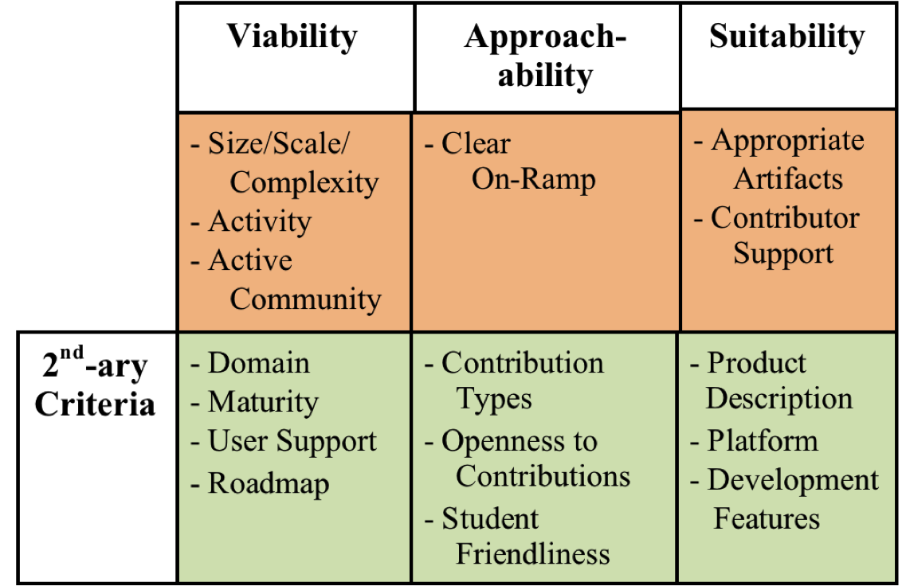
The Model - 1
Notes:
Need a better graphic
Here discuss the model from high level
Dimensions
Viability-is it a community that is likely to continue? Is the project too complex?
Approachability – does it appear that it is a project that students can contribute to without having to spend an inordinate amount of time identifying how to do so?
Suitability – does it support the learning objectives?
Mission critical – evaluated first, pass or fail (do have to satisfy all criteria)
Secondary criteria – scored-approach (don’t have to satisfy all criteria)

Slide 25
The Model - 2
Rate criteria on scale of one to three
  Three is “best”
Mission Critical Criteria: Must be present to support student success
  No rating of less than two is acceptable
Secondary Criteria: Contribute to the success but lack does not lead to failure
  Total score above 20 indicates a viable project

Slide 26
Mission Critical
Viability – Size, Scale Complexity
Remember that students do not need to understand entire project
LOC: 96 KLOC – 5 MLOC
  Very dependent on architecture
Architecture: Modular architectures best
  E.g., plug-in architecture
Number of committers: ~6 within the last 12 months

Slide 27
Mission Critical
Viability – Activity
Commits per month: 10-30 is reasonable
  Look back a year or so for commit pattern
  Projects may have cyclic commit pattern

Slide 28
Mission Critical
Viability – Community
Active user and developer communities
Regular history of project downloads
Regular documentation updates
Current activity on user mailing lists
Be careful of:
  Long lags between updates
  Current questions unanswered on forums
  No recent history of downloads

Slide 29
Mission Critical
Approachability – On-ramp
Must have identifiable way for new people to contribute
Rubric:
  Insufficient: few or no pointers on how to get involved
  Sufficient: Suggestions about how to get involved other than contributing money
  Ideal: Obvious link to getting started including list of tasks needed to be completed and detailed instructions

Slide 30
Mission Critical
Suitability – Appropriate Artifacts
Must have artifacts/tasks that support learning for your class
  Documentation, testing, design, coding, etc.
  Multiple opportunities for a variety of different kinds of contributions is best

Slide 31
Mission Critical
Suitability – Contributor Support
Ideal: Community provides lots of guidance
Project should contain information on how project is administered and managed
Communication tools clearly documented
Developers have a web presence
Processes for getting change committed, feature selection etc. well documented.
Responses to questions on IRC/list should be supportive and timely

Slide 32
Secondary
Viability – Domain and Maturity
Domain: Understandability can impact learning
  E.g., Software for Nuclear Magnetic Resonance vs. gaming software
Maturity: Should have at least one stable release
  Otherwise project may not have sufficient organization to support student learning

Slide 33
Secondary
Viability – User Support & Roadmap
User Support: Clear instructions for downloading, installing and using product
  FAQs, forums, and lists
  Quality of end-user documentation
Does project have clear roadmap for future?
  Provides students with understanding of forward direction

Slide 34
Secondary
Approachability – Contribution Types and Openness
Support for multiple contribution types?
  More is better
Openness to contributions
  Does project accept external patches
  Description of how to get changes committed
  Identification of committers
  Be wary of projects that do not accept changes not from core members

Slide 35
Secondary
Approachability – Student Friendliness
Ideal project welcomes and values student contributions
  Check tone of discussion on IRC and forums
  Is “flaming” is tolerated?
Evidence of previous student participation is helpful
  E.g., Google Summer of Code

Slide 36
Secondary
Suitability
Product: Students must be able to understand what product does
Platform: Do you have support for platform project runs on?
Development features:
  Programming language
  Development environment
  Supporting technologies: database packages, libraries, etc.

Slide 37
Other Factors
Sizzle! Is project attractive to students?
Long-term prospects: Is this a project that could be used for more than one term?
Ownership: Does project hold possibility for students to have a sense of “ownership”?
  Will students want to follow the project during future development?

Slide 38
7. An Example

Slide 39
8. Your Turn! Applying the Model

Slide 40

Questions?
Links:
  Foss2serve – http://foss2serve.org
  Teaching Open Source – http://teachingopensource.org
  http://HFOSS.org
  Producing Open Source Software - http://producingoss.com/
  The Cathedral and The Bazaar http://catb.org/~esr/writings/homesteading/
  http://OpenSouce.com
  http://openhatch.org

