Slide 1
Inspire-CT
From Middle School to Industry: Vertical Integration to Inspire Interest in Computational Thinking

Slide 2
Welcome

Slide 3
Introduction
Welcome to Daytona Beach!
Logistics
Schedule and breaks
Meals
Restrooms

Slide 4
Introductions
The Inspire-CT team
All participants
Where are you from?
What do you do?
Vertical integration?

Slide 5
Broad Trends

Slide 6
Decline in Computing Students
Apparent public perception that computing is a poor career choice
Dot com bubble burst
Off-shoring of jobs
AP Computer Science Exam
Further decline among under-represented groups
37% of CS degrees in 1985 received by women
12% of CS degrees in 2008 received by women

Slide 7
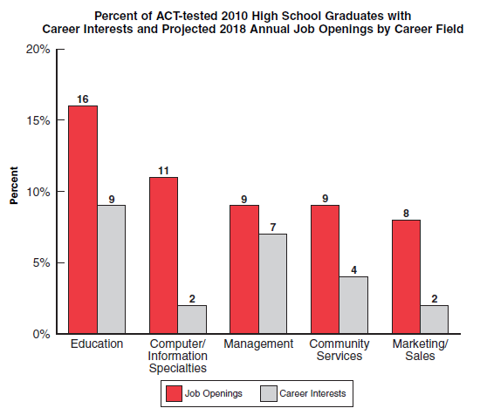
Opportunity in Computing Careers

Slide 8
Computing Competency
The shortfall isn’t just among computing majors and computing professionals
Increasingly computing competency is required for all professions
Not just computer literacy!
Computational thinking

Slide 9
Computational Thinking

Slide 10
Computational Thinking
What is computational thinking (CT)?
Not clearly defined, but getting better
Not clearly persistent as a concept
Prominent in NSF solicitations
Broadening Participation in Computing (BPC)
CISE Pathways to Revitalized Undergraduate Computing Education (CPATH)
Computing Education for the 21st Century (CE21)

Slide 11
ISTE/CSTA Definition
Computational thinking (CT) is a problem-solving process that includes (but is not limited to) the following characteristics:
Formulating problems in a way that enables us to use a computer and other tools to help solve them.
Logically organizing and analyzing data
Representing data through abstractions such as models and simulations
Automating solutions through algorithmic thinking (a series of ordered steps)
Identifying, analyzing, and implementing possible solutions with the goal of achieving the most efficient and effective combination of steps and resources
Generalizing and transferring this problem solving process to a wide variety of problems

Slide 12
ISTE/CSTA Definition
These skills are supported and enhanced by a number of dispositions or attitudes that are essential dimensions of CT. These dispositions or attitudes include:
Confidence in dealing with complexity
Persistence in working with difficult problems
Tolerance for ambiguity
The ability to deal with open ended problems
The ability to communicate and work with others to achieve a common goal or solution

Slide 13
Inspire-CT

Slide 14
Root Ideas
Need for computational thinkers
Computing majors: 62,000 grads for 155,000 positions
Non-computing majors: CT requirements in STEM and beyond
Creating inspiration and motivation
Harnessing the excitement of capstone design
Integrating and applying skills and knowledge throughout the curriculum

Slide 15
Root Ideas
Appealing to women and other under-represented groups
Application
Collaboration
Creativity
Communication
Impacting students before college

Slide 16
Approach
Active learning
Peer mentoring and modeling of success
Significant computing experience earlier
Within the undergraduate curriculum
In grades 6-12
Extension to industry
Career alignment
Mentoring and modeling for advanced undergrads

Slide 17
Professional Software Designers and Developers
Industry Collaborators
Clients, Mentoring, and Review
Capstone Design Team
Experienced Computing Majors
Undergraduate Teams
Subcontracting and Mentoring
Less Experienced Majors
Non-computing Majors
Mentoring and Participant-observers
High School Teams
Middle School Teams
Pre-college Participants

Slide 18
Challenges
Coordinating across courses and instructors
Partitioning projects for vertical integration
Meaningful participation by industry
Instructor’s role
Instructional material
Instructional time

Slide 19
Up Next
Experiences with Vertical Integration

